Slide 1
UNIT V SECURING STORAGE INFRASTRUCTURE
Information security goals
Storage security domains
Threats to a storage infrastructure
Security controls to protect a storage infrastructure
Governance - risk - and compliance
Storage infrastructure management functions
Storage infrastructure management processes.

Slide 2
Information security goals
1. Introduction
Information security is the process of protecting information and storage resources from unauthorized access, modification, disclosure, destruction, or disruption.
In a storage infrastructure, large amounts of important organizational data are stored in servers, storage arrays, SAN/NAS systems, backup devices, cloud storage, and databases. Therefore, protecting stored data is an essential part of storage management.
The main goals of information security are commonly represented by the CIA Triad:
  Confidentiality
  Integrity
  Availability
These three goals ensure that data is accessed only by authorized users, remains accurate, and is available whenever required.

Slide 3
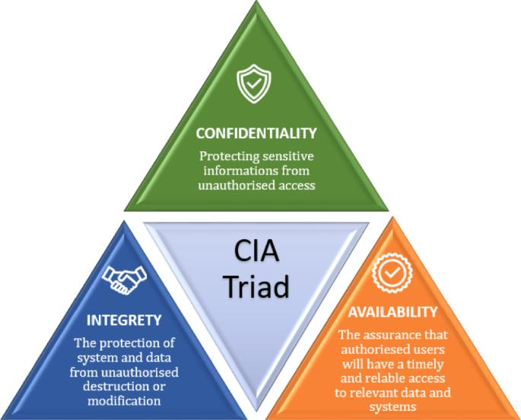
CIA Triad
Confidentiality + Integrity + Availability = Information Security

Slide 4
2.1 Confidentiality
Definition
Confidentiality ensures that information is accessible only to authorized users, applications, and systems.
The objective is to prevent unauthorized people from viewing or obtaining sensitive information.
Examples
A student database should be accessible only to authorized staff.
Confidential employee records should not be visible to ordinary users.
Customer information stored in a storage array should be protected from unauthorized access.
Backup data should also be protected because it may contain complete copies of organizational information.

Slide 5
Methods used to achieve confidentiality
1. Authentication
  Verifies the identity of a user.
  Example: Username and password.
2. Authorization
  Determines what an authenticated user is allowed to access.
  Example: Only the Placement Head can modify placement records.
3. Access control
  Restricts access to files, folders, databases, and storage devices.
4. Encryption
  Converts readable data into an unreadable format.
  Data can be decrypted only by an authorized user with the appropriate key.
5. Network security
  Firewalls, VPNs, and secure communication protocols help prevent unauthorized access.
Simple example
If a company's salary database can be viewed only by authorized HR employees, confidentiality is maintained.

Slide 6
2.2 Integrity
Definition
Integrity ensures that information remains accurate, complete, consistent, and unaltered by unauthorized users or processes.
The data should not be modified, deleted, or corrupted without proper authorization.
Examples
A student's placement status should not be changed by an unauthorized person.
Backup files should not be modified or corrupted.
Database records should remain accurate.
An attacker should not be able to modify transaction records.

Slide 7
Methods used to achieve integrity
1. Access controls
  Prevent unauthorized modification.
2. Hashing
  Generates a unique value representing the contents of a file.
  Any modification to the file can result in a different hash value.
3. Digital signatures
  Help verify the authenticity and integrity of information.
4. Checksums
  Used to detect accidental data corruption.
5. Audit logs
  Record who accessed or modified information.
6. Backup and recovery
  Helps restore correct information if data becomes corrupted or is maliciously modified.

Slide 8
Simple example
Suppose a database contains:
Student Marks = 85
An unauthorized person changes it to:
Student Marks = 95
The integrity of the data has been violated.

Slide 9
2.3 Availability
Definition
Availability ensures that information, applications, and storage resources are accessible to authorized users whenever required.
Data may be confidential and accurate, but it is not useful if authorized users cannot access it when needed.
Causes of availability problems
Hardware failure
Disk failure
Network failure
Power failure
Natural disasters
Cyberattacks
Ransomware
Denial-of-Service attacks
Software failures

Slide 10
Methods used to achieve availability
1. RAID
  Provides protection against disk failures.
2. Redundant components
  Multiple power supplies, network connections, controllers, etc.
3. Backup
  Provides a copy of data for recovery.
4. Replication
  Maintains copies of data at another storage system or location.
5. Disaster recovery
  Helps restore IT services after a major failure.
6. High-availability systems
  Reduce service interruption by using redundant systems.
7. Failover
  Automatically transfers operations to a standby system when the primary system fails.
Simple example
If a college's student database server fails but a standby server immediately takes over, students and staff can continue using the application. This provides availability.

Slide 11
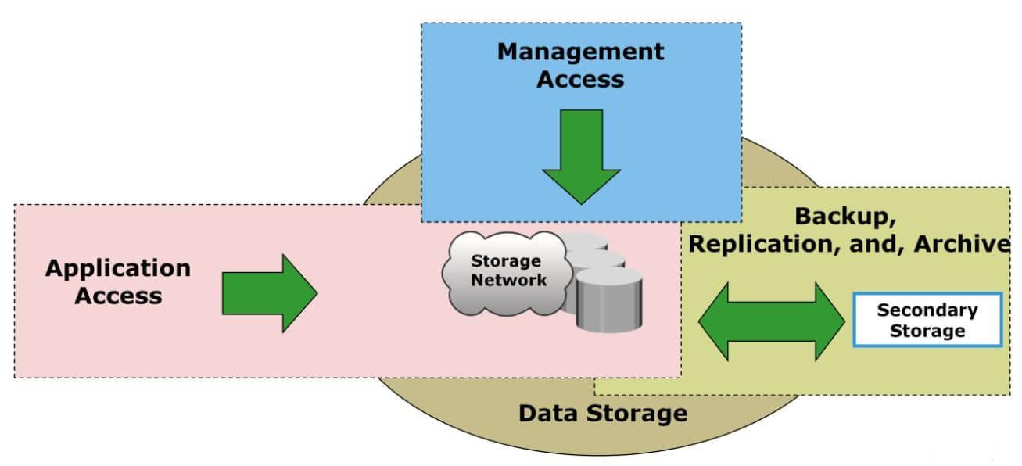
Storage Security Domains
Storage security is not limited to protecting disks. A storage infrastructure contains multiple components, and each component can introduce security risks.
Storage security domains are different areas of a storage environment that must be protected to ensure overall security.
The major storage security domains include:
  Application domain
  Host domain
  Network domain
  Storage system domain
  Management domain
  Physical domain

Slide 12
Application Domain
The application domain consists of applications and databases that create, process, and access stored information.
Examples:
  Banking applications, ERP applications, Hospital applications, Student information systems, Web applications DBMS
Security threats
  Application vulnerabilities, SQL injection
  Unauthorized application access, Malware
  Poor password management, Improper access permissions
Security measures
  Application authentication, Role-based access control
  Secure coding, Database access controls
  Encryption, Regular security updates
Example
A college ERP application accesses student records.
If an unauthorized person gains access to the ERP application, sensitive student data may be exposed.
Therefore, the application layer must be secured.

Slide 13
Host Domain
The host domain includes servers, computers, and other systems that access storage resources.
Examples:
  Application servers , Database servers, File servers , Virtual machines , Backup servers
Security threats
  Malware, Viruses, Unauthorized login
  Compromised operating systems, Improper configuration, Unpatched software
Security measures
  Operating system hardening, Antivirus/endpoint protection, Host-based intrusion detection
  Firewalls, User authentication, Patch management, Access control
Example
A database server connects to a SAN.
If the database server is compromised, an attacker may attempt to access the SAN storage.
Therefore, securing only the SAN is not sufficient; the host must also be protected.

Slide 14
Network Domain
The network domain consists of the communication infrastructure used to transfer data between hosts and storage systems.
Examples:
Ethernet switches, Fibre Channel switches, Routers, Network interfaces, SAN fabric, iSCSI networks
Security threats
  Network sniffing
  Unauthorized access
  Spoofing
  Man-in-the-middle attacks
  Denial-of-Service attacks
  Unauthorized network connections

Slide 15
Security measures
1. Network segmentation
Storage traffic can be separated from normal user traffic.
2. VLANs
VLANs can logically separate network traffic.
3. Zoning
In Fibre Channel SANs, zoning controls which devices can communicate with each other.
4. Encryption
Encryption protects data while it travels through the network.
5. Firewalls
Firewalls control permitted network connections.

Slide 16
Storage System Domain
The storage system domain contains the actual storage infrastructure where data is stored.
Examples:
HDDs, SSDs, Storage arrays, SAN, NAS, RAID systems, Storage controllers
Security threats
  Unauthorized storage access
  Disk theft
  Data deletion
  Data corruption
  Controller compromise
  Unauthorized configuration changes

Slide 17
Security measures
8.1 Access control
Only authorized hosts and users should access storage resources.
8.2 Encryption
Data can be encrypted before or while it is stored.
8.3 RAID
RAID provides redundancy and helps maintain availability during disk failures.
8.4 Secure deletion
When storage devices are retired, data should be securely erased so that it cannot be recovered easily.
8.5 Storage monitoring
  Storage systems should be monitored for:
  Unauthorized access
  Configuration changes
  Failed disks
  Suspicious activity

Slide 18
Management Domain
The management domain includes the tools and interfaces used to configure, monitor, and administer storage infrastructure.
Examples:
Storage management software, Management servers, Administrator consoles, Monitoring systems, Configuration interfaces
Why is it important?
A storage administrator may have extensive privileges.
If an attacker gains administrator-level access, the attacker could:
  Delete data
  Modify storage configurations
  Create unauthorized users
  Disable security controls
  Destroy backups
Security measures
  Strong administrator authentication
  Multi-factor authentication
  Role-based access control
  Separate administrative accounts
  Audit logging
  Secure management protocols
  Regular monitoring

Slide 19
Physical Domain
The physical domain protects the physical infrastructure containing storage systems.
Examples:
Data center, Server room, Storage racks, Disk drives, Power systems, Cooling systems,Backup media
Physical threats
Theft, Fire, Flood, Unauthorized entry, Earthquake, Power failure, Overheating
Security measures
  Physical access control
  CCTV surveillance
  Security guards
  Biometric access
  Fire detection and suppression
  UPS
  Backup power generators
  Environmental monitoring
  Secure storage of backup media

Slide 20
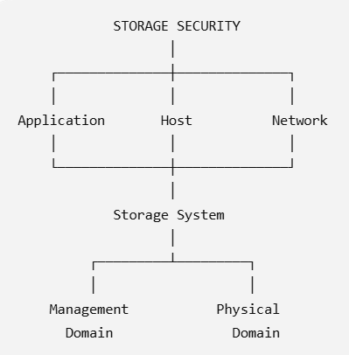
Storage Security Domains – Overall View

Slide 21
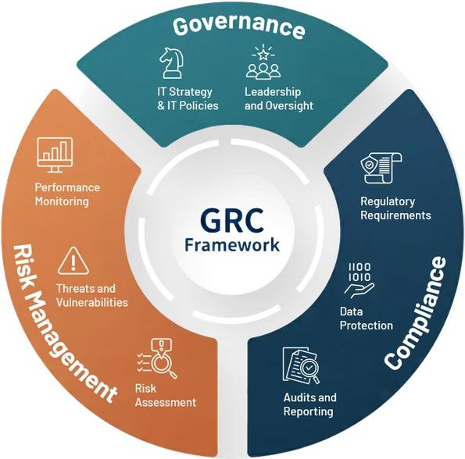
Governance, Risk and Compliance (GRC) in Storage Security
Governance, Risk, and Compliance (GRC) is an important part of securing storage infrastructure. It provides a systematic approach to managing organizational data, identifying security risks, and ensuring that the organization follows applicable laws, regulations, standards, and internal policies.

Slide 22
1. Governance
Governance refers to the policies, procedures, responsibilities, and decision-making processes used to manage and protect an organization's information and storage infrastructure.
Governance answers: "How should we manage and protect our data?“
Objectives of Governance
Establish security policies.
Define responsibilities and ownership.
Ensure proper management of storage resources.
Establish security standards and procedures.
Monitor whether security policies are being followed.
Support business objectives and data protection requirements.

Slide 23
Examples of Storage Governance
An organization may create policies such as:
  Only authorized employees can access sensitive data.
  Backup must be performed every day.
  Critical data must be replicated to a secondary site.
  Old storage devices must be securely erased before disposal.
  Storage administrators must use strong authentication.
  Security logs must be reviewed regularly.
Important Components
1. Policies
Define what is permitted and what is prohibited.
2. Procedures
Describe how security policies should be implemented.
3. Roles and responsibilities
Clearly identify who is responsible for:
  Data, Storage, Security, Backup, Disaster recovery
4. Monitoring
Regularly check whether policies are being followed.

Slide 24
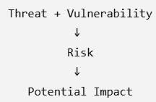
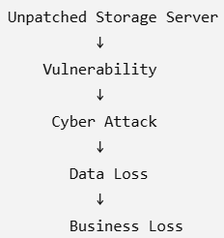
Risk
Risk is the possibility that a threat may exploit a vulnerability and cause damage or loss to an organization.
Risk answers: "What can go wrong, and how serious will it be?“
Basic Risk Relationship
For example:

Slide 25
Common Storage Security Risks
Unauthorized access
Data theft
Data corruption
Malware and ransomware
Hardware failure
Accidental deletion
Loss of backup media
Natural disasters
Insider threats
Poorly configured storage systems

Slide 26
Risk Assessment
Risk assessment is the process of identifying, analyzing, and evaluating risks.
STEPS:
Identify Assets
↓
Identify Threats
↓
Identify Vulnerabilities
↓
Analyze Risk
↓
Determine Impact
↓
Prioritize Risks
↓
Apply Security Controls
↓
Monitor and Review
Example
Suppose an organization stores customer information on a storage array.
Asset: Customer database
Threat: Ransomware
Vulnerability: No isolated backup
Impact: Loss of customer data and business interruption
Risk: High
Control: Maintain offline/isolated backup and regularly test recovery.

Slide 27
Risk Management
Risk management is the process of identifying, evaluating, treating, and continuously monitoring risks.
There are four common approaches to risk treatment.
1. Risk Avoidance
Eliminate the activity that creates the risk.
Example: Stop using an insecure legacy storage protocol.
2. Risk Mitigation
Reduce the probability or impact of the risk.
Example: Use encryption, access controls, MFA, and network segmentation.
3. Risk Transfer
Transfer some or all of the financial consequences of a risk to another party.
Example: Cyber insurance or outsourcing certain services to a trusted provider.
4. Risk Acceptance
Accept the risk when its impact is low or the cost of reducing it is greater than the expected benefit.

Slide 28
Compliance
Compliance means ensuring that an organization follows applicable laws, regulations, standards, contractual requirements, and internal policies.
Compliance answers: "Are we following the required rules and standards?“
Compliance is particularly important when organizations store sensitive information such as:
Personal information
Financial information
Healthcare information
Intellectual property
Customer information
Employee information

Slide 29
Types of Compliance Requirements
A. Legal Requirements
Organizations must comply with applicable laws and regulations.
B. Regulatory Requirements
Specific industries may have additional requirements.
For example:
Banking
Healthcare
Telecommunications
Government

Slide 30
Types of Compliance Requirements
C. Industry Standards
Organizations may follow standards and frameworks such as:
ISO/IEC 27001
NIST Cybersecurity Framework
COBIT
PCI DSS
D. Organizational Policies
An organization may establish its own security policies.
Example:
"All critical data must be backed up daily and backup restoration must be tested periodically."

